Slide 1
Cryogenic Distribution
Tom Peterson, SLAC
USPAS
January, 2017

Slide 2
Cryogenic distribution
This portion of the class will focus on certain topics in the design and fabrication of distribution equipment for large cryogenic systems
Transfer lines
Feed and distribution boxes

Slide 3
Distribution function
These devices serve as the interface from a cryogenic plant to specialized cryogenic equipment.
Such cryogenic "boxes" may include
Thermal transitions of various kinds
Power leads for electric current
Instrumentation
Vacuum barriers
Control valves, relief valves, etc.

Slide 4
Outline Cryogenic distribution
Transfer lines
Vacuum barriers
Lambda plugs
Feed and distribution boxes
LCLS-II distribution system overview

Slide 5
Cryogenic transfer lines
Techniques have become fairly standard
Stainless vacuum pipe
Stainless (or sometimes copper) inner lines
Plastic or composite material (e.g., G-11 epoxy-fiberglass) supports

Slide 6
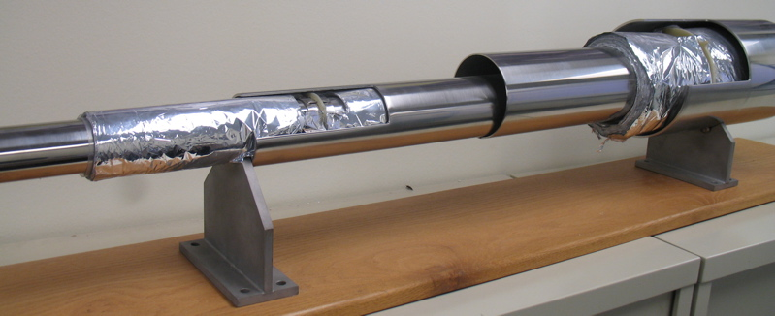
Fermilab’s 4.5 K transfer line
Liquid nitrogen space
Insulating vacuum space
Insulating vacuum space
Inner pipe (4.5 K helium)
Supplies 4.5 K, supercritical (3 bar) helium over 6 km to “satellite” refrigerators
Also provides LN2

Slide 7
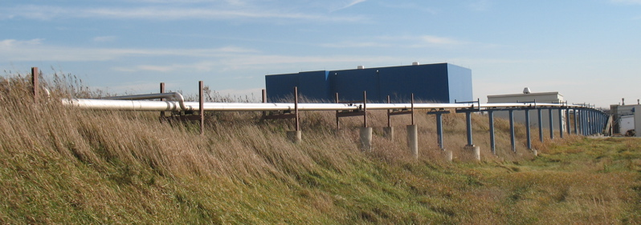
Fermilab’s 4.5 K transfer line
Outside on top of the accelerator enclosure, a full 6 km circumference ring
Here a bypass around a building

Slide 8
Common transfer line issues
Long lengths mean many welds
Leak checking may be a challenge
Division of insulating vacuum into manageable sections
Thermal contraction allowance
Bellows and flexible hose, quality control issues
Different lines may shrink or expand first
Inner line supports
Wear or bind with frequent thermal cycles
May involve use of plastics, requiring use of proper materials to avoid brittle failures

Slide 9
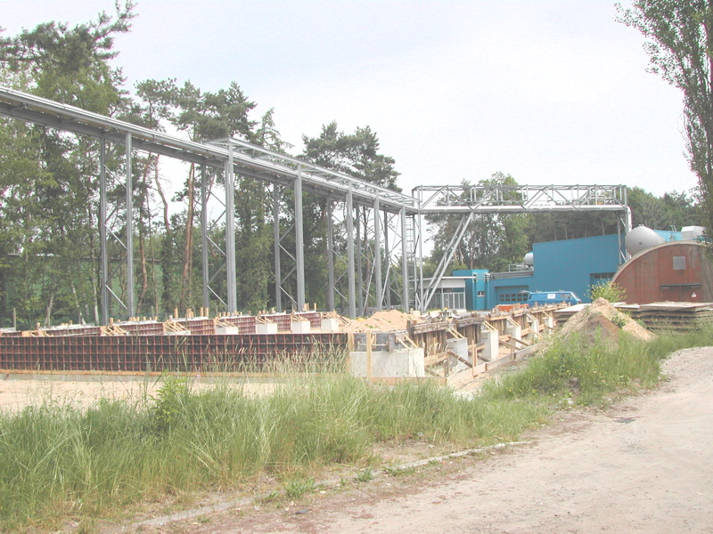
DESY TTF transfer line - 1
4.5 K and thermal shield flow from HERA cryo-plants to TTF

Slide 10
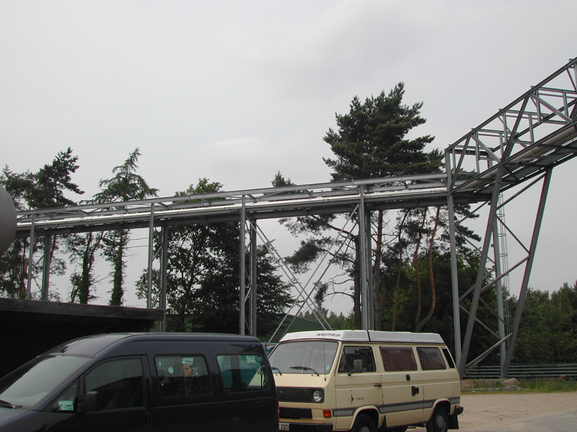
DESY TTF transfer line - 2
4.5 K and thermal shield flow from HERA cryo-plants to TTF

Slide 11
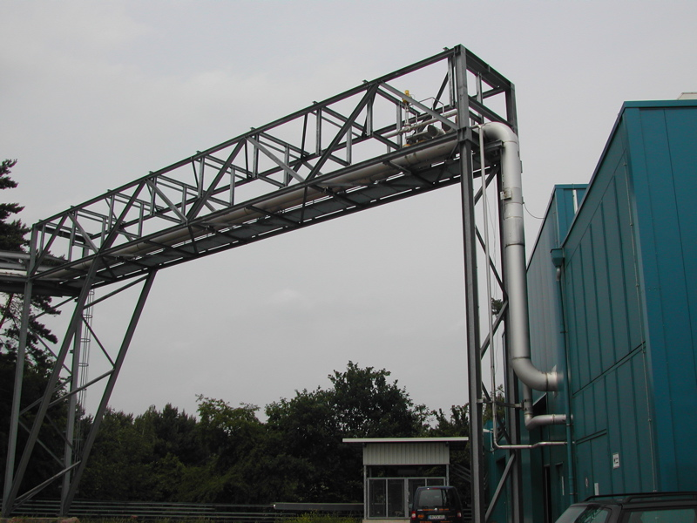
DESY TTF transfer line - 3
Entrance to TTF building (Hall 3)

Slide 12
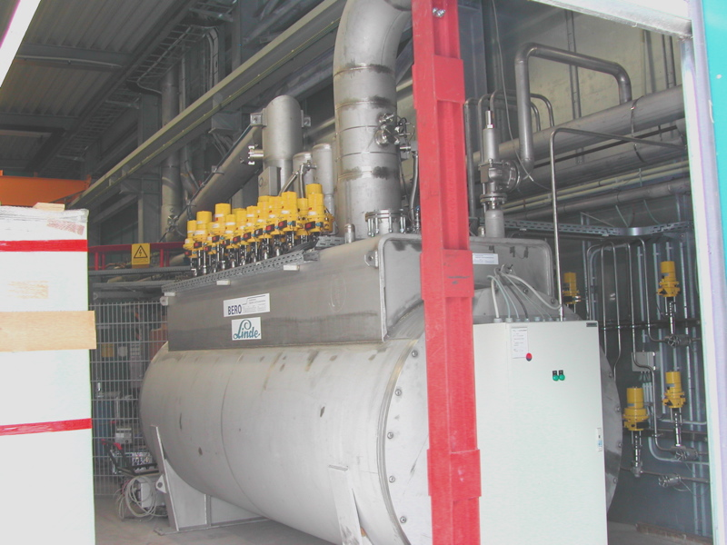
DESY TTF transfer line - 4
Distribution box at TTF end of transfer line

Slide 13
From Vittorio Parma (CERN) -- Provides nice comparison of
cryostat and transfer line structures

Slide 14
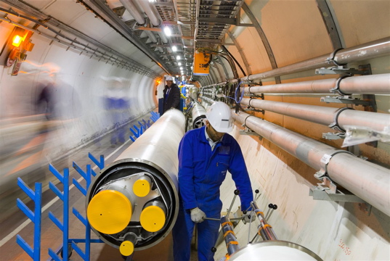
CERN QRL installation

Slide 15
Reported transfer line heat loads
Tevatron (C. Rode, et. al., in Advances in Cryogenic Engineering, Vol 27, pg. 769)
80 K to 4.5 K ~33 mW/m (48 mm OD)
300 K to 80 K ~0.5 W/m
HERA (M. Clausen, et. al., in Advances in Cryogenic Engineering, Vol 37A, pg. 653)
40-80 K to 4.5 K ~130 mW/m (60 mm supply + 140 mm return), consistent with about 210 mW/m² of inner line (compare to 50 mW/m² for heat load through MLI)
300 K to 40-80K ~1.0 W/m
LEP flexible transfer lines (H. Blessing, et. al., in Advances in Cryogenic Engineering, Vol 35B, pg. 909.
30 mW/m on inner (4.5 K) line (13 mm OD)

Slide 16
Some reported transfer line costs
CERN and Fermilab estimate from recent experience
~$8000/meter for large (600 mm OD vac jacket) transfer line (installed cost)
Fermilab estimate
~$1000/meter for typical, small 4.5 K transfer line (installed cost)

Slide 17
Vacuum barriers
Separate insulating vacuum into manageable sections
Leak checking and trouble-shooting
Reduce extent of accidental loss of vacuum
Regions for vacuum instrumentation

Slide 18
Vacuum barrier schematic

Slide 19
CERN’s Short Straight Section Vittorio Parma -- CERN

Slide 20
Vacuum barrier in SSS

Slide 21
Lambda plugs
An end box for pressurized superfluid will need to pass instrumentation and power into the superfluid region
Feedthrough via vacuum space, directly to SF volume
Risk of helium to vacuum leak
Feedthrough via 4.5 K helium space to superfluid space
Must limit heat transfer from 4.5 K to 2 K
This is sometimes called a “lambda plug”
Typically required for current leads
LHC has many
Failure results in a heat load to 2 K level

Slide 22
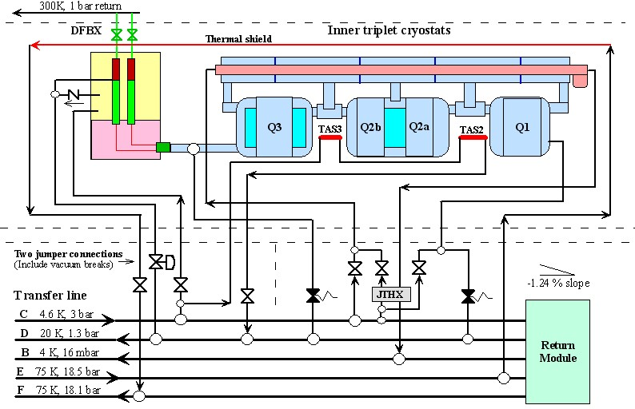
Simplified LHC magnet cooling scheme
2 K
4.5 K
Lambda plug

Slide 23
Lambda plug fabrication (LBNL)- 1
Superconducting cable potted in an insulating block of G10-CR
Plane of reinforcement parallel to faces
Four 8 kA cables and 24 200-600 A cables
Plug design and procedures developed at Berkeley Lab

Slide 24
Lambda plug fabrication - 2
Encapsulated in Stycast 2850MT (blue) epoxy using hardener 24LV
Application via injection in a vacuum chamber

Slide 25
Lambda plug installed -1 View of lambda plug from 4.5 K helium vessel

Slide 26
Lambda plug installed -2 View of lambda plug installation from vacuum space

Slide 27
Lambda plug installed -3 View of support flange and 1.9 K pipe from insulating vacuum space

Slide 28
Allowable leak rate -- example
For these lambda plugs, an allowable leak rate was determined based on allowable heat transport through a crack
0.15 mm channel results in less than 1 mW heat from 4.5 K side to 1.9 K side
Channel size converted to an equivalent room temperature air flow
Air leak rate measured as a QC check

Slide 29
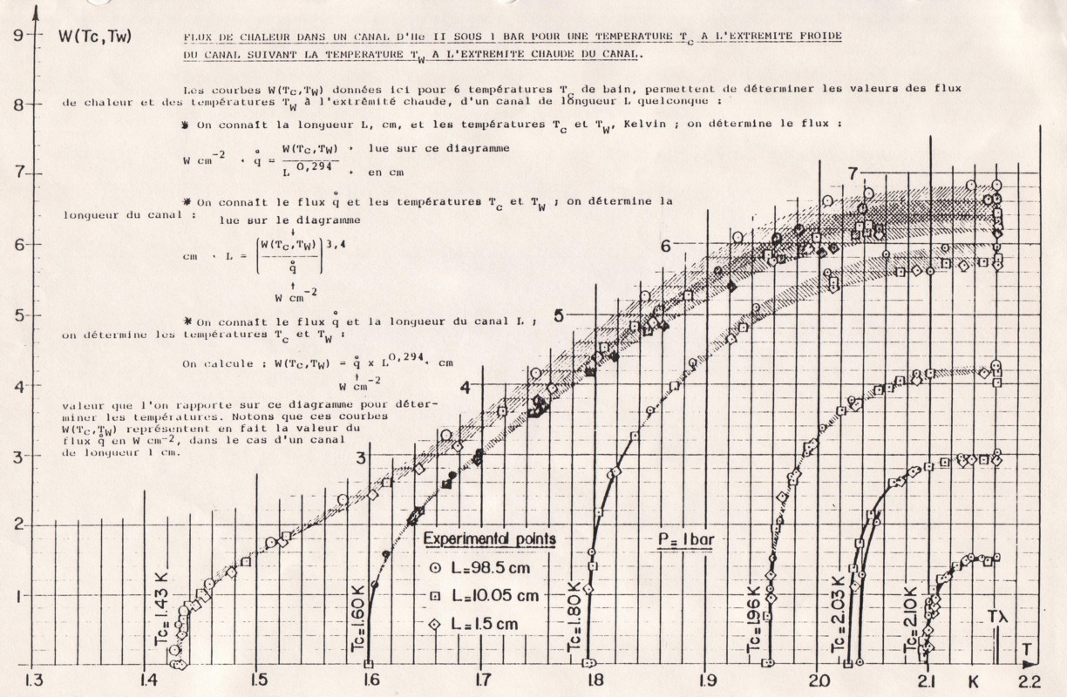
From Tc = 1.9 K to T-lambda, W = 4.8
For L = 5 cm, heat flux q = 3.0 W/sq.cm.
For a 0.15 mm diameter channel, the
heat transferred is less than 1 mW

Slide 30
TTF feed box
TESLA Test Facility (TTF) at DESY is a small SRF system, so feed box is like an SRF test feed box
Receives 4.5 K He
Internal heat exchangers for 2 K generation
Connection to large room temperature pump
Designed and built at Fermilab for TTF at DESY

Slide 31
TTF feedbox schematic
Photo of this on the next page

Slide 32
TTF feedbox internal
Heat exch
2 K end of piping
4.5 K to 2 K heat exchanger
Large vent line
Note short braided hose on large vent pipe for small thermal motion
Copper thermal shield
Large vent
pipe

Slide 33
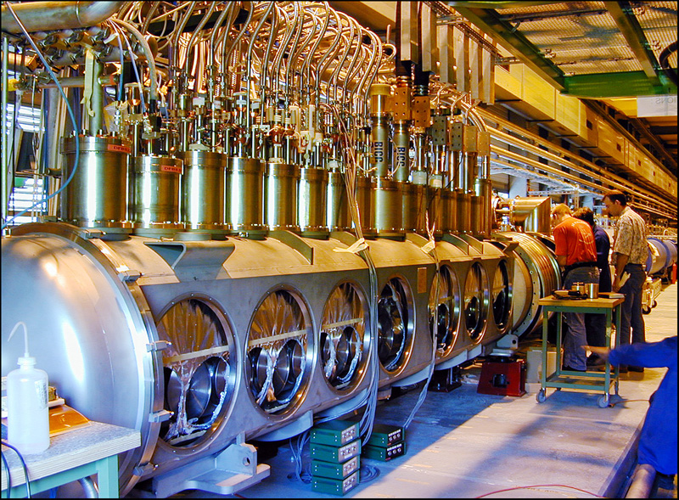
LHC test string 2 feed box (CERN)
Many current leads and ports for access to make splice joints

Slide 34
Distribution box: DFBX
Distribution feed boxes (DFBX) for LHC at CERN
Designed by Lawrence Berkeley National Lab with assistance from Fermilab
Provide cryogens, electrical power, and instrumentation interface between CERN cryogenic system and US-supplied final focus quadrupoles

Slide 35
LHC magnet cooling scheme

Slide 36
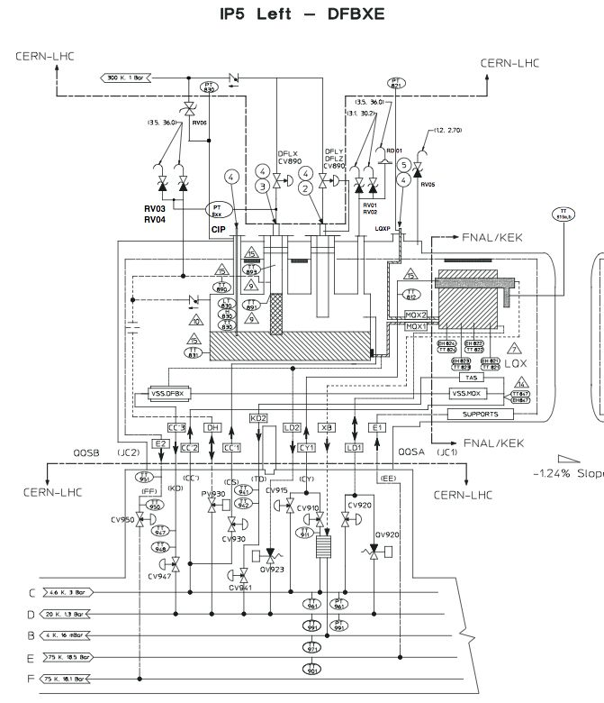

Slide 37
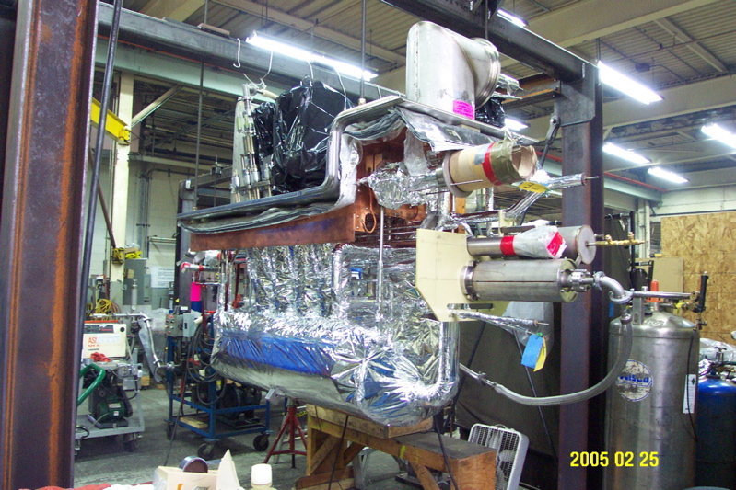

Slide 38
LCLS-II Cryogenic Distribution

Slide 39
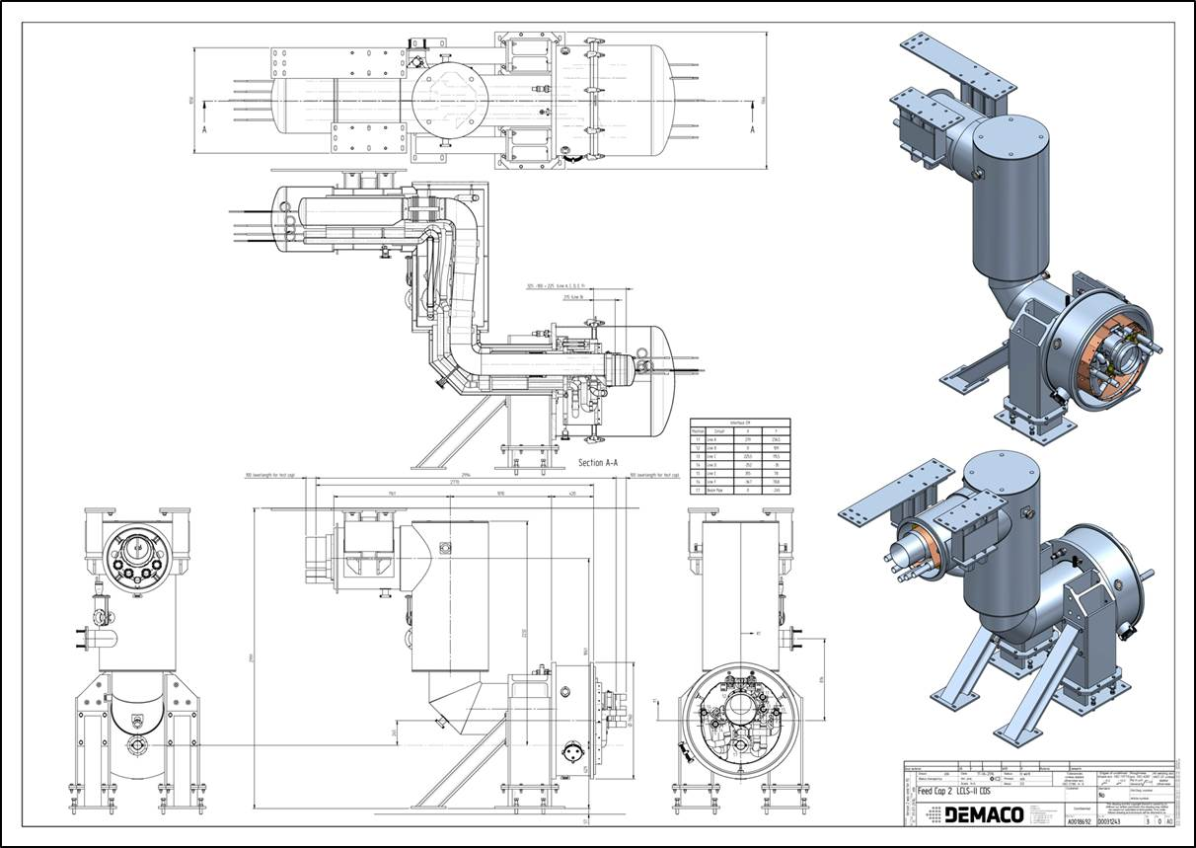
LCLS-II Feed Caps 2 and 4 (Arkadiy Klebaner, Fermilab, and DEMACO)

Slide 40
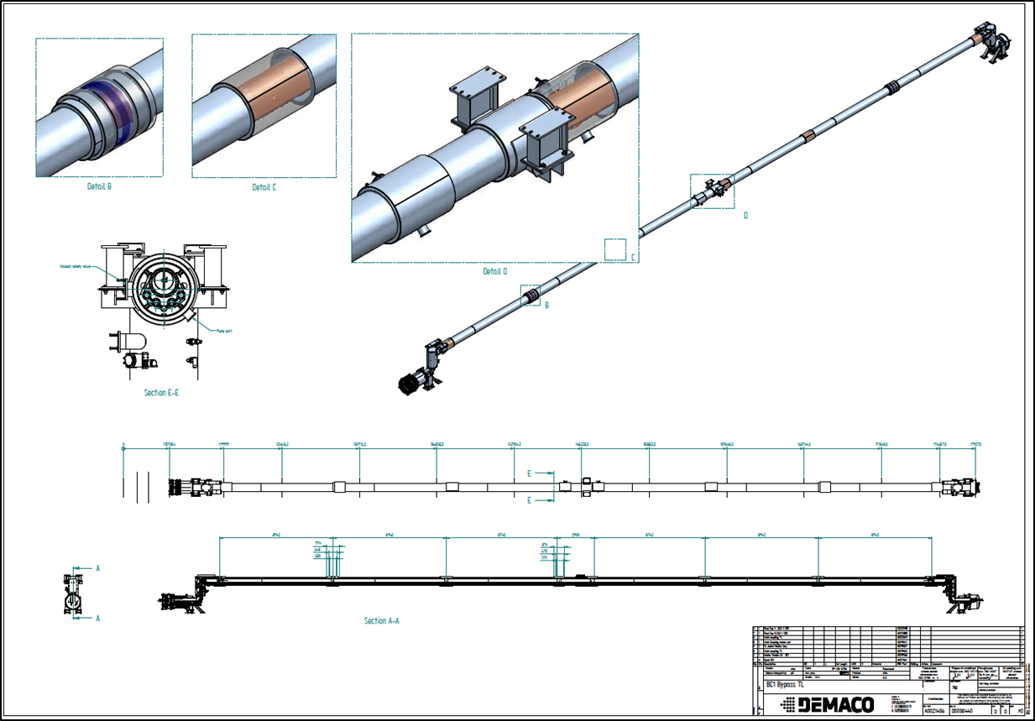
LCLS-II BC1 Bypass (Arkadiy Klebaner, Fermilab, and DEMACO)

Slide 41
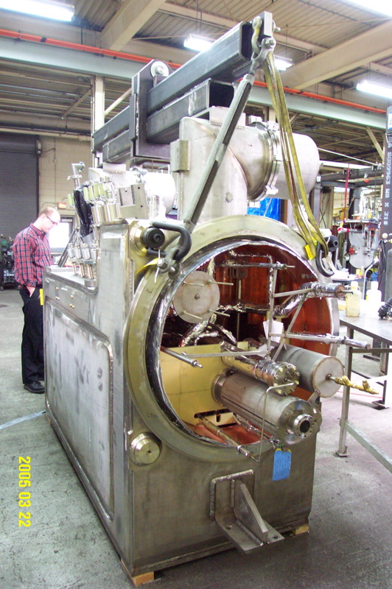
Conclusion:
Cryogenic distribution equipment
often occupies a major fraction
of cryogenic engineering time
for a project. It may be non-
standard, integrates many
different components into one
cryostat, and involves sizing of
valves, relief valves, pipes,
pressure vessel issues, heat
transfer considerations, etc., etc.
Significant and interesting
mechanical engineering!

Slide 42
References
V. Parma, “Construction Experience of the LHC Cryostats,” presentation at ILC GDE meeting, 11 Sep 2007
C. Rode, et. al., “Fermilab Tevatron Transfer Line,” in Advances in Cryogenic Engineering, Vol 27, pg. 769.
M. Clausen, et. al., “Cryogenic Test and Operation of the Superconducting Magnet System in the HERA Proton Storage Ring,” in Advances in Cryogenic Engineering, Vol 37A, pg. 653.
H. Blessing, et. al., “Very Low-Loss Liquid Helium Transfer with Long Flexible Cryogenic Lines,” in Advances in Cryogenic Engineering, Vol 35B, pg. 909.

